Slide 2

Build an Audio Browser app with Blazor
Steven Sanderson
Developer/Architect, Microsoft
@StevenSanderson

Slide 3

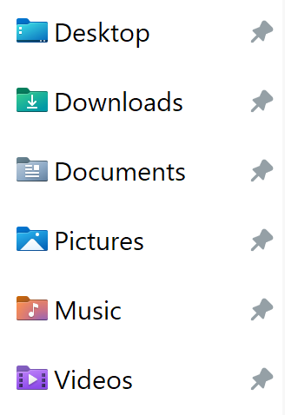



This PC
> Documents > Recordings
Intro.mp3
Guest1.mp3
?
Ad.mp3
Interview.mp3
https://yoursite
Intro.mp3
Guest1.mp3
Ad.mp3
Interview.mp3

Slide 4
Access local files
Directory list, styling
PLAN OF ATTACK
Improve UI
Grid, sorting, searching
Render previews
Decode audio, generate waveforms
Performance
Virtualization, AOT

Slide 5
Learn more
ASP.NET Core in .NET 7 overview:
https://aka.ms/aspnet/7
Code from this talk:
https://github.com/SteveSandersonMS/AudioBrowser

Slide 6
Build an Audio Browser app with Blazor
Steven Sanderson
Developer/Architect, Microsoft
@StevenSanderson

